Slide 1
iGeneration
Scholarship Program for academic year 2017/2018

Slide 2
What we do
iGeneration is a philanthropic non-profit organization, focusing on financing Georgian students’ international education
iGeneration Foundation (IGF) Scholarship Program at University of Limerick (UL), Ireland, is open for undergraduate Georgian students who are citizens of Georgia

Slide 3
What we do (cont’d)
The program targets academically qualified, yet economically disadvantaged young people in Georgia
iGeneration offers up to 2 full scholarships per year, for four-year Bachelor Degree Courses, preferably in Business, Science or Engineering

Slide 4
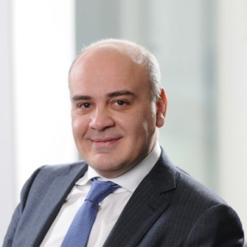
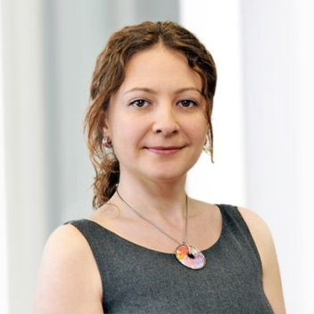
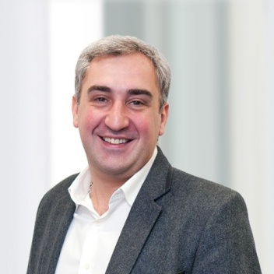
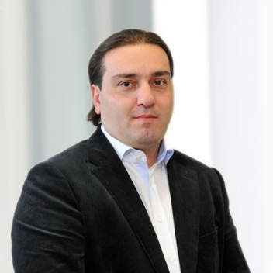
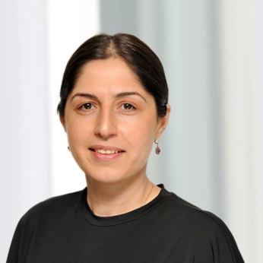
Who we are
Irakli Gilauri
Founder and Chairman
UL Alumnus
Kety Kinkladze
Founder and Board Member
Nika Gilauri
Board Member
UL Alumnus
Vano Sturua
Board Member
UL Alumnus
Eka Duchidze
Executive Director

Slide 5
Why we do
We believe that good education is the key to success
iGeneration Board Members (UL alumni) aim to give opportunity to Georgian students whose families can not afford foreign education

Slide 6

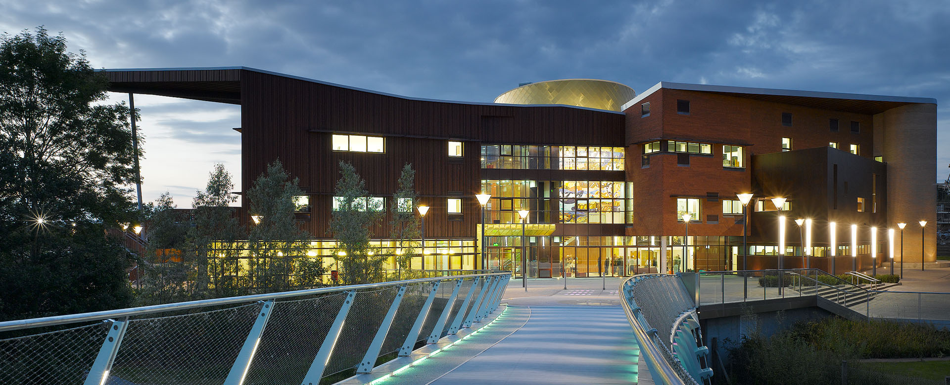
Why University of Limerick

Slide 7
Why University of Limerick (cont’d)
Leading academic institution in Ireland for business, science and engineering
High quality programs in international education
13,000 students

Slide 8
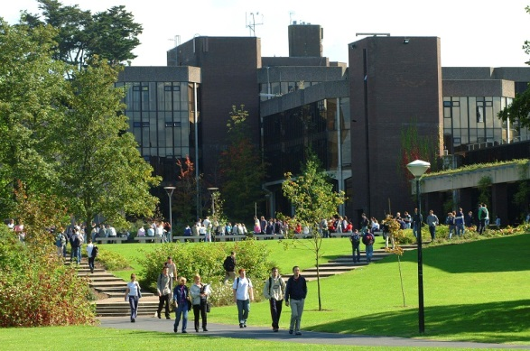
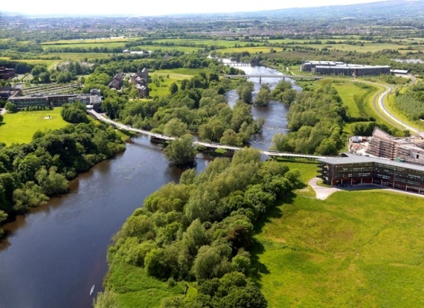
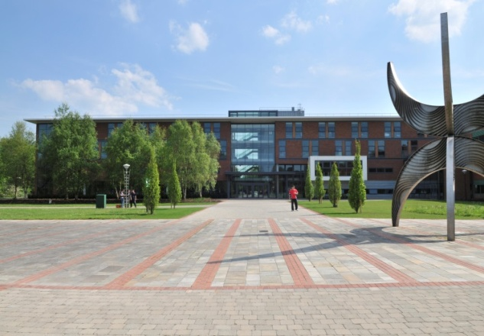
Why University of Limerick (cont’d)
Remarkable campus (137 hectares)
Incredible facilities: 40 buildings, which includes a stadium, swimming pools, arena, library, cafes & restaurants, etc.
On campus student villages (accommodation)

Slide 9
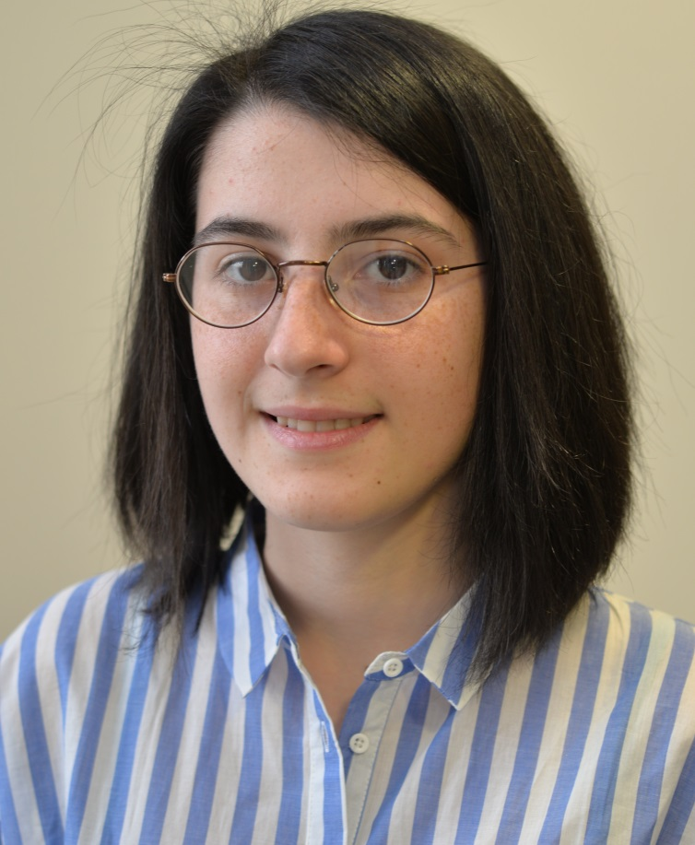
Who are the Scholars of 2014
ELENE MINDADZE
Elene Mindadze was born in Kutaisi in 1994 where she attended Public School specializing in Physics and Math. In 2012 she successfully passed nation-wide Unified National Exams getting her into top 10 best students out of more than 30,000 exam-takers and as a result she was accepted into prestigious Free University of Tbilisi (FUT) to study Business Administration.
Her family’s inability to financially support her did not deter Elene to pursue her studies at FUT. Elene worked hard to get a scholarship for her studies at FUT.
She wants to follow the footsteps of her deceased father to become an auditor “he was the best in Kutaisi” she says, “I want to be one of the best on a bigger scale”. Elene was accepted to do Bachelor of Business Studies with Japanese in UL.
iGeneration board was impressed by Elene’s academic achievement. Her intelligence, determination and ability to grow were the key factors for the Board to vote unanimously for awarding Elene with iGeneration Scholarship.

Slide 10
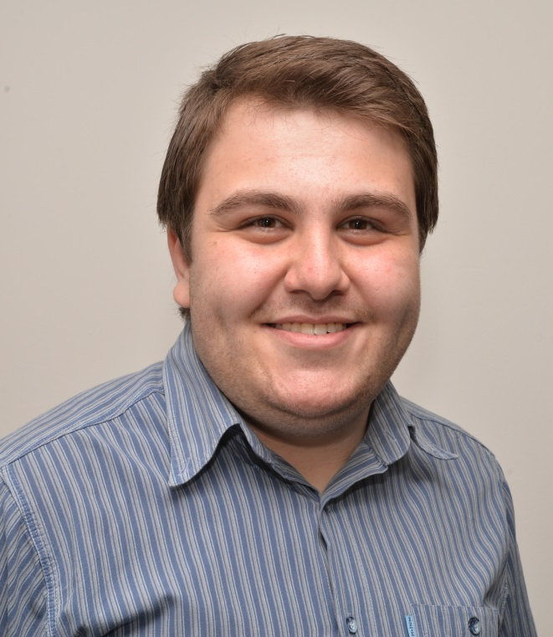
Who are the Scholars of 2014 (cont’d)
ALEKSANDRE ZIBZIBADZE
Aleksandre (Sandro) Zibzibadze was born in Tbilisi in 1993 and attended Tbilisi Public School, which he graduated from with Golden Medal (distinction). In 2009, Alexandre won the FLEX scholarship and spent an exchange year at high school in Arizona, US.
In 2011 Alexandre passed Unified National Exams receiving full state scholarship and was accepted into Free University of Tbilisi to study Business Administration. He has won various awards in debate and public speaking competitions and contributed to the establishment of various speech and debate clubs and societies.
He has always tried to be socially active, participating in various conferences and seminars for students in Europe. Alexandre was accepted to study International Business Administration in UL.
At the interviews Aleksandre showed confidence and good judgment while addressing different questions, after which the whole board unanimously voted in his favor.

Slide 11
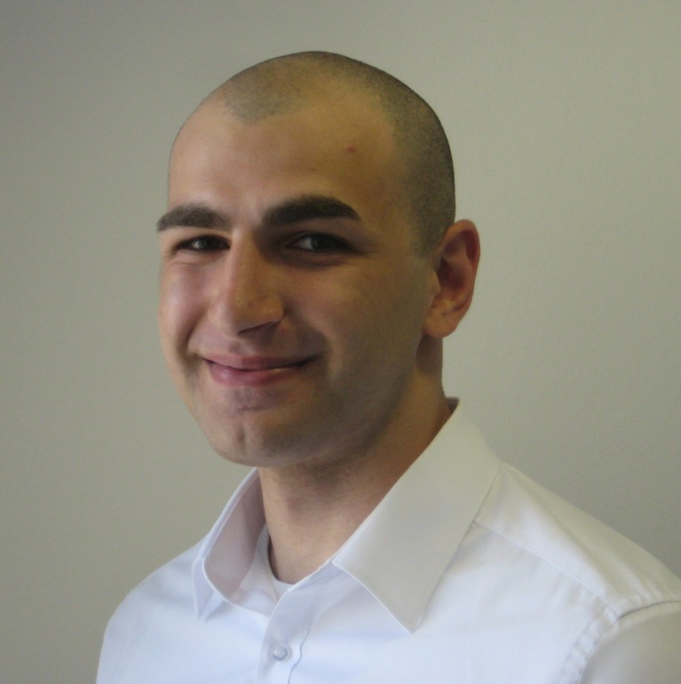
Who is the Scholar of 2015
GIORGI DOLIDZE
Giorgi Dolidze was born in Tbilisi, in 1993. He attended a Public School from where he graduated with distinction (a Golden Medal).
In 2011, Giorgi successfully passed the Georgian Unified Exams, granting him a full state scholarship. The same year he enrolled at the Free University of Tbilisi to study Physics. During his studies, Giorgi was also a member of various student organizations, where he strove to make a positive impact on the Georgian society.
At the University of Limerick, Giorgi was accepted to study Construction Management and Engineering. While studying at UL, he is determined to obtain valuable knowledge for his career and to be at the forefront of building a better future for his country. He is also looking forward to making the most of the University’s diverse choice of clubs and sports.

Slide 12
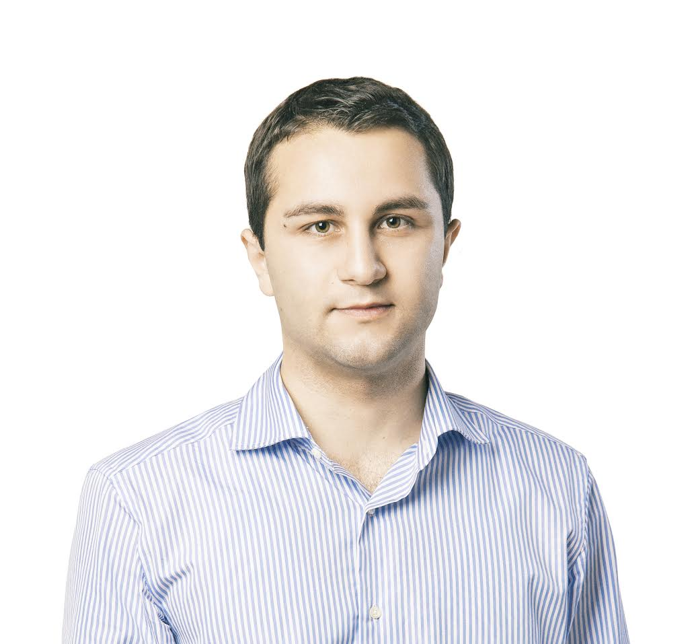
Who is the Scholar of 2016
Davit korkelia
Davit (Dazi) Korkelia was born in Rostov-on-Don (Russia), in 1994. Shortly after his birth, his family moved to Poti, where he attended a Public School. In 2013, Davit graduated the Public School with distinction (a Silver Medal) and successfully passed the Unified National Exams getting him a full State Scholarship. The same year he was enrolled at the Free University of Tbilisi to study Business Administration majoring in Finance.
In 2014, Davit won the national Public Speaking competition in London (UK), representing Georgia among more than 60 participants from different countries. He has attended various summer schools winning National Olympiads and other tournaments.
At the University of Limerick, Davit was accepted to study International Business concentrating in Finance and Economics. Davit believes that Georgia has a potential to become a financial hub in the region and he wants to take a part in capital market development process in Georgia.

Slide 13
What we offer
The 4-year Scholarships fully cover:
Tuition fee
Accommodation at UL campus (Kilmurray village)
2 round trip tickets per year to Dublin
Monthly stipend of €350 to cover living expenses
Other expenses: insurance, books, visa, TOEFL or IELTS test fee

Slide 14
Who can receive Scholarship
Only students who receive offer from UL
Georgian citizens up to 23 years at the time of applying
1st, 2nd and 3rd year student of an authorized Georgian university
Holders of Secondary School Leaving Certificate examination with an average grade B or higher (or equivalent)

Slide 15
Who can receive Scholarship (cont’d)
Fluent knowledge of English (TOEFL or IELTS certificate)
Unified National Exam with an average grade of 60% in Ability Test
Minimum score of 60% in the Unified National Exams in Mathematics Test for student applying for a Bachelor Degree in Science or Engineering

Slide 16
Where to apply
Student should apply to UL and IGF scholarship simultaneously:
Fill out the UL application form: goo.gl/ZNS4HY
Fill out IGF Scholarship Program form: http://iGeneration.ge
Email these forms to international@ul.ie no later than 1 May 2017
WARNING: Any attempts to approach the iGeneration’s Board or Management, directly or through third persons, for other than information purposes, will automatically lead to disqualification of applicant
Note: Students who would like to register for paper based TOEFL test please contact natia@osgf.ge and nino@osgf.ge before 7 April, 2017. For more please contact Center for International Education at: 577 401674

Slide 17
Thank you

