Slide 1


HUMAN RIGHTS & PRIVATE LAW
Compensating damages to human rights: constitutional limits for the Spanish legislature
Fernando Peña
Universidade da Coruña

Slide 2
I. HUMAN RIGHTS & PRIVATE LAW

Slide 3
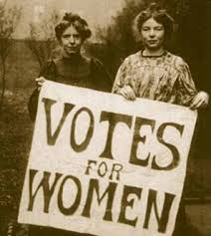
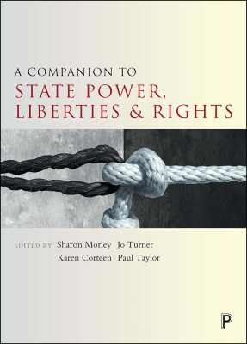


Slide 4



Slide 5

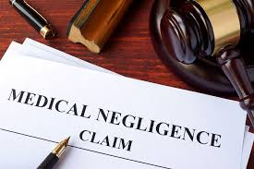


Slide 6


Slide 7




Slide 8
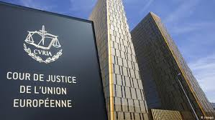
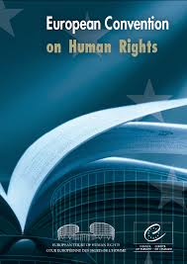
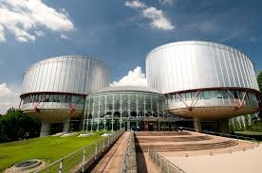
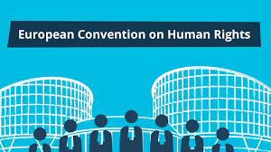

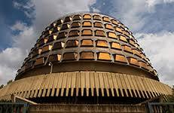
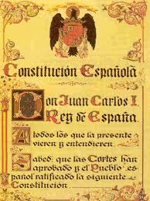

Slide 9


GLOBALIZATION OF LAW
TO CONFRONT
GLOBALIZATION OF ECONOMY

Slide 10

Do Human Rights apply to horizontal relations in Spain?
What human rights ?
Have those human rights the same meaning and content when applied to horizontal relations?
Are they applied directly or indirectly to these relationships?
What kind of remedies are available for the victims of Human Rights’ violations in private law?
How are damages to Human Rights compensated in Spain?

Slide 11
II. HUMAN RIGHTS IN HORIZONTAL RELATIONS IN SPAIN

Slide 12


Must private persons be bound by the same restrictions and limits to his activities as the State?
Must private citizens comply with the public standards of political correctness required from the State?
Have public and private law the same underpinning values?

Slide 13
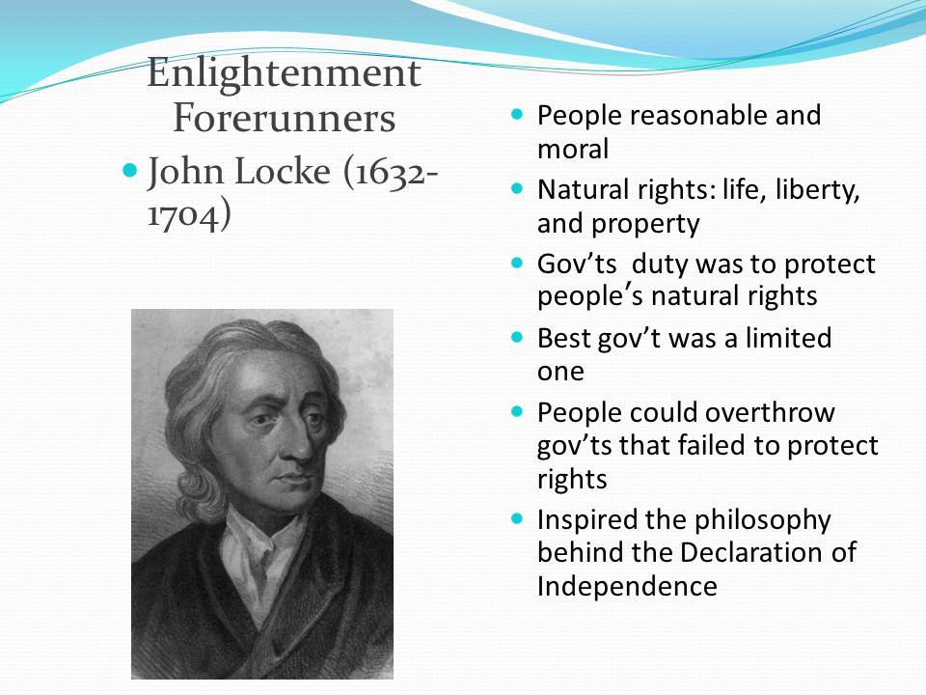
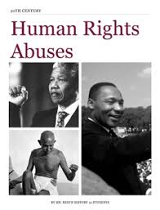

Slide 14

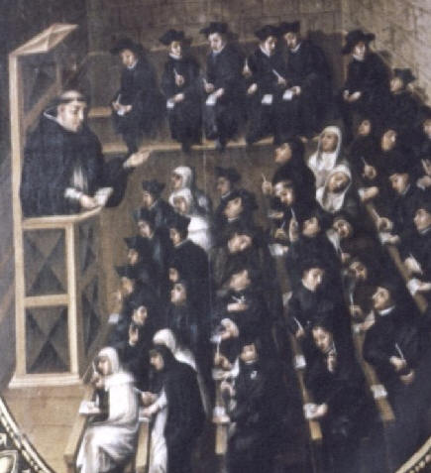
HUMAN RIGHTS AND PRIVATE LAW RELATIONS
In Spain, human rights protection is historically linked to private law:
The legal doctrine of the «personality rights» was used during the Franco dictatorship by private law scholars to affirm a protected space for all citizens, free from the interference of the government or other individuals.
The personality rights theory has its roots in the Spanish scholastic, so that the Catholic confessional regime of Franco did not have any mistrust towards it.
This way, Spanish scholars could speak of right to life, to physical integrity or to privacy without being suspect of sympathy for democracy.

Slide 15

After the enactment of the Spanish Constitution of 1978:
Nobody questioned the efficacy of fundamental rights in horizontal relations.
The Constitutional Court recognised expressly that Fundamental rights can be infringed either by the State or private citizens (STC 177/1988, 10 October).

Slide 16
III. WHAT HUMAN RIGHTS?

Slide 17

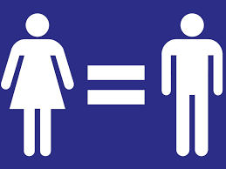
WHAT HUMAN RIGHTS ARE RELEVANT
IN HORIZONTAL RELATIONS?
There is not a list of fundamental rights that are applicable only to horizontal relations or to vertical relations...
But, in practical terms, there is a group of human rights that has been considered to be usually affected by conducts of private citizens:
The old rights to personality:
Right to life
Right to phisical and mental integrity
Right to honour and privacy
And some additional rights that have been constantly present in the Spanish courts’ decisions on human rights in this area:
Freedom of expression (freedom of information)
Right to equality (gender, religion, nationality, race)
Freedom of religion

Slide 18
IV. HAVE THOSE RIGHTS THE SAME MEANING AND CONTENT IN PUBLIC AND PRIVATE LAW?

Slide 19



Slide 20


DO HUMAN RIGHTS HAVE THE SAME MEANING AND CONTENT IN HORIZONTAL AND VERTICAL RELATIONS?
WEAPONS AGAINST
THE STATE’S POWER
V.S.
ASSETS THAT COEXIST WITH EACH OTHER AND MAY BE TRADED BY THEIR OWNERS

Slide 21
Right
Right
A WORLD OF BALANCING
Right to privacy vs. Freedom of information
Right to dignity vs. Right to freedom (individual autonomy)

Slide 22

BROADCASTING HIDDEN CAMARA RECORDINGS
(TC, March 2019)
It is only allowed when there is no other way of getting the information and making it public

Slide 23


A KILLING GAME: THE LASERDROME CASE
(ECJ, C-36/02, 2004)
Balances do not have to produce the same results

Slide 24



HUMAN RIGHTS ACQUIRE A DIFFERENT MEANING IN PRIVATE LAW
The role of CONSENT:
In the right to like and phisycal integrity (informed consent, transplants, etc.)
In the right to data protection
In the right to privacy

Slide 25

BUT, EVEN IN PRIVATE LAW, SOMETIMES THE BALANCE WE HAVE TO MAKE IS NOT ONLY BETWEEN RIGHTS, BUT BETWEEN RIGHTS AND GENERAL INTERESTS

Slide 26


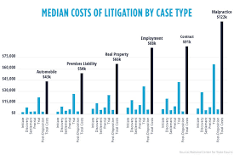
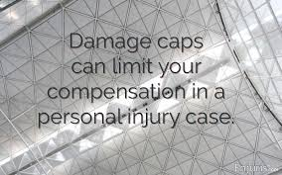
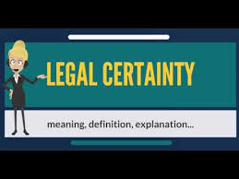

Slide 27



ECJ Case C‑131/12 Google Spain SL and Google Inc. v Agencia Española de Protección de Datos (AEPD) and Mario Costeja González

Slide 28
V. HOW ARE HUMAN RIGHTS APPLIED IN PRIVATE LAW DISPUTES?

Slide 29

WHAT IS THE SPANISH MODEL FOR APPLYING HUMAN RIGHTS TO HORIZONTAL RELATIONS?
Indirect application model (I): Courts interpret private law from the perspective of human rights.
Direct application model: every person has a cause of action to sue whoever violates his/her human rights

Slide 30



PERMEATE ALL LEGAL CATEGORIES AND INSTITUTIONS
LEGAL SYSTEM
IDEOLOGY
SYSTEM’S FOUNDATIONS
COMMON BASIC VALUES

Slide 31

ALL CASES ARE ABOUT HUMAN RIGHTS VIOLATIONS COMMITTED BY THE SIGNING STATES…
…BUT MANY TIMES IT DEALS WITH PRIVATE LAW CASES

Slide 32
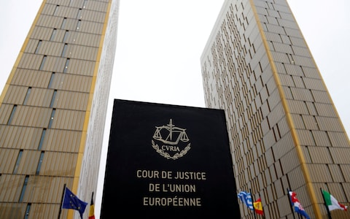
Art. 6.2 TUE. The Union shall respect fundamental rights, as guaranteed by the European Convention for the Protection of Human Rights and Fundamental Freedoms signed in Rome on 4 November 1950 and as they result from the constitutional traditions common to the Member States, as general principles of Community law.

Slide 33

Art. 10.1. The human dignity, the inviolable and inherent rights, the free development of the personality, the respect for the law and for the rights of others are the foundation of political order and social peace.

Slide 34
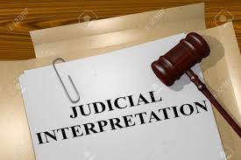
INDIRECT PROTECTION
First method: Legal categories and general concepts are to be defined from the perspective of human rights.
HR define what is against public policy
HR define the level of diligence
HR define what is an abuse of rights

Slide 35
INDIRECT PROTECTION
Second method: The Spanish judiciary is considered to be bound by human rights, so that no court’s decisicion can go against or curtail human rights. In the event that a judicial decree does it, it will be overruled.
It can be appealed to the Constitutional Court (53.2 CE)
The CC has the reins of the protection system

Slide 36

In Spain you can file a lawsuit against any private person that has violated your human rights:
Sometimes there is a specific statute that stablishes the specific available remedies against the violation (Act 1/1982 on civil protection of rights to honour and privacy, Act 15/1999 on personal data protection)
Even if there is no such a statute, any citizen is considered to have a cause of action in these cases (STS 26.10.1995 [RJ 1995\7849] decides on a case of infringment of the right of association). There is a special quick preferential proceeding for these cases.
DIRECT PROTECTION

Slide 37

That you have a cause of action just alleging a violation of your HR
That you do not need to use the typical private actions
But that is not normally what happens…..

Slide 38

WHAT KIND OF REMEDIES ARE AVAILABLE FOR THE VICTIMS?
All private law remedies are available to victims:
Contractual remedies
Tort law remedies
Other general remedies…
The only condition is that they
must be EFFECTIVE
But the most important general
remedies are:
Injunctions
DAMAGES

Slide 39
VI. THE CASE OF THE COMPENSATION FOR DAMAGES TO HUMAN RIGHTS

Slide 40





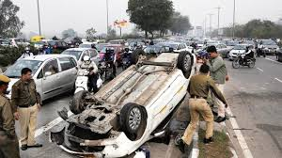
EL BAREMO
“The scale”

Slide 41


THE PROBLEM OF EVALUATING DAMAGES
Economic Damages
Non Economic Damages

Slide 42
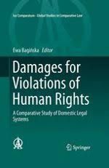
Violating a human right whatsoever always produces non economic damages.
It could also cause economic damages, but that is not necessary.
Think about:
Right to privacy
Right to physical integrity
Freedom of movement…

Slide 43


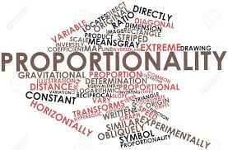

Slide 44
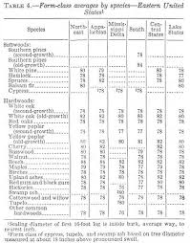
CONSTITUTIONAL LIMITS TO THE COMPENSATION OF DAMAGES TO HUMAN RIGHTS
The origin of these constitutional limits is the enactment in 1995 of a statutory-established scheduled compensation of damages in the Spanish system (“el baremo”).
A system composed of several scales and tables that must be used to calculate the compensation for any “personal damage” (damages to life or to the physical and mental integrity of a person)
A Court cannot grant a higher compensation than the amount of money allocated in “el baremo” for that kind of injury. The “baremo” is a system that establishes caps on damages

Slide 45
System was challenged before the Constitutional Court on the basis that it infringed the right to life, the right to physical and mental integrity and the human dignity. The system was said to leave people without compensation for damages that they proved during the process.
This constitutional appeal give the CC the occassion to establish constitutional limits of any legislation related to compensation of damages to human rights

Slide 46
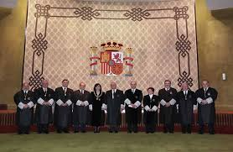
The CC doctrine is a good example of how the content of human rights in private law is the result of balancing the different rights (tortfeasor, victim) and interests (compulsory insurance) involved in the contemplated situation
In principle, compensation must be calculated according to the principle of integral reparation of damages.
BUT…
The legislature
can introduce caps
on damages
as long as they
Respect some basic
Rules.

Slide 47
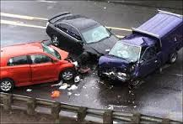
GENERAL RULE:
THE REASONABILITY TEST
The high number of accidents, the danger of the harmful activity considered, the existence of compulsory insurance (collective responsability) justified the limits in the field of car accidents.

Slide 48

It goes against the Constitution not to compensate at all the non-economic damages derived from a human right violation (excluding a specific injury from compensation).
The amount of damages given in compensation for non-economic damages has to be in accordance with the person’s dignity (the dignity test)

Slide 49

CAPS ON ECONOMIC
DAMAGES
Economic damages to human rights can only be limited in the framework of a strict liability regime.
Economic damages to human rights cannot be limited when the injure was intentional or the result of a reckless conduct (relevant fault). Contributory negligence excludes this situation.

Slide 50


