Slide 1
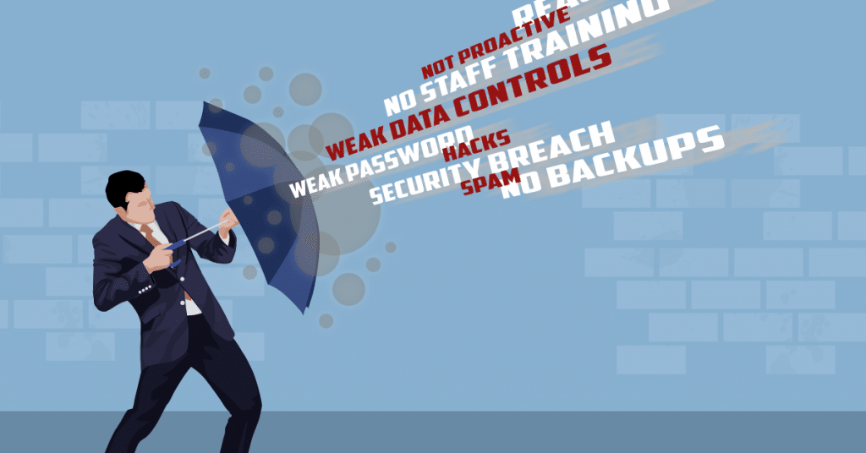
Joan Lluís Pérez-Francesch
Universitat Autònoma de Barcelona
Institut de Ciències Polítiques i Socials
“Tensions between Freedom and Security in Contemporary World”

Slide 2
THE FUTURE OF DEMOCRACY:
LIBERTY VS SECURITY
Tensions between Freedom and Security in Contemporary World
The rising tension between the values of liberty and security in the social and democratic state of law is our object of study.
- We have focused on three fields:
International terrorism threats and transnational criminality.
Cyber security.
civility and coexistence in our local context.

Slide 3
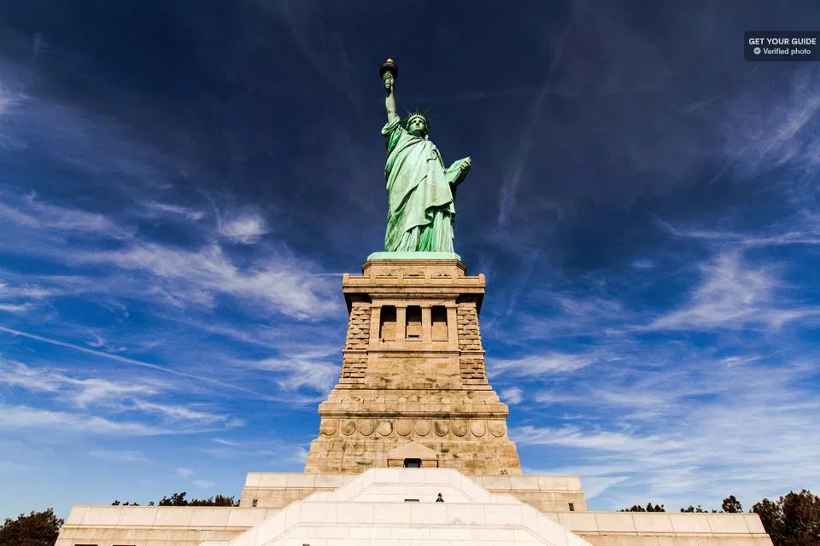
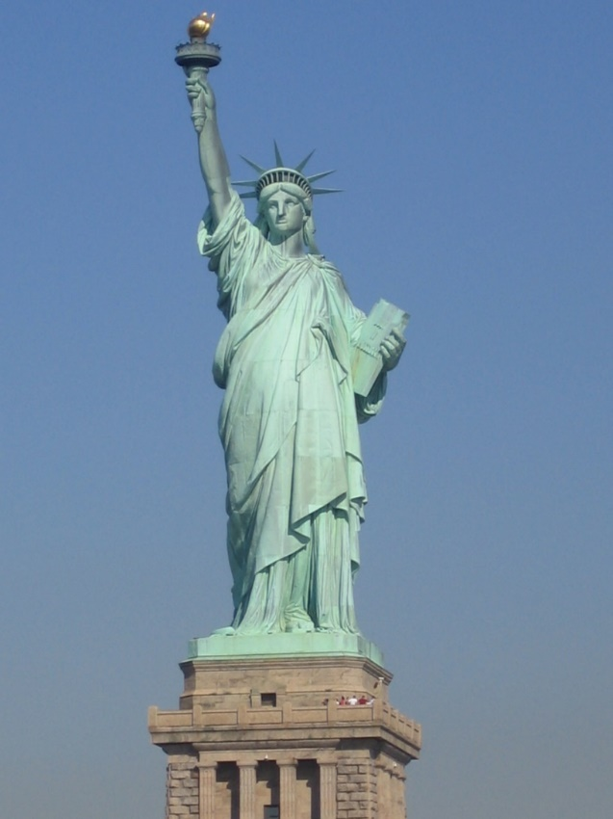
Tensions between Freedom and Security in Contemporary World

Slide 4
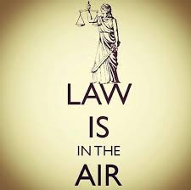
Tensions between Freedom and Security in Contemporary World
Why are fundamental rights important?
There is an “constitutional culture” way of thinking and doing based on liberty.
What is the meaning of political freedom: to abide by the rules. The issue here is how is the law made and guaranteed.
What kind of guarantees justice system offers and how they are used to delimit the abuse of authority(political power).

Slide 5
Tensions between Freedom and Security in Contemporary World
What comes after the 9/11 terrorist attacks:
- Obsession for security reinforcement.
What kind of security: global threats, internal and external security of the state become the same thing, fear management.
Financial crisis of 2007 makes it worse. Welfare State crisis.
State crisis in a supra-state, interstate and globalized environment. Priority is given to the existential security of the State and its citizens, in a context of structural crisis that every State will have to readjust their role and its own functions.
Guarantee total security is impossible.

Slide 6
Tensions between Freedom and Security in Contemporary World
To decide who are the enemies: such as Daesh, Boko Haram, Al Qaeda, so on. Which are very confusing due to their environment to determinate so (global and undeterminated).
As a consequence: Politicians can make few statements which can be very populist, xenophobe and can increase the hate speech against refugees and no national people.
The fear and the feeling of insecurity have spread. And the threats of radicalized jihadists groups →taking any measure will have an effect on everyone. It is necessary to foresee knowing the expenses.

Slide 7
Tensions between Freedom and Security in Contemporary World
What kind of problem occurs:
Modify the institutional schemes of the rule of law (checks and balances, guarantee fundamental rights, rule of law).
Strengthening security can lead to a kind of permanent or normalized state of exception (Carl Schmitt).
“Patriot Act” in the USA.
Guantánamo prisoners issue.
“We are” going toward a police state.
The intelligent agencies have a new role. Prevention.

Slide 8
Tensions between Freedom and Security in Contemporary World
Restriction of rights guarantees(the numbers of days of preventive detention has increased, communication control, search warrants and preventive controls.)
Extreme cases: "flights of the CIA", torture, illegal evidence obtained abroad, "hot" return on the border, etc.
Very specific threats that can not be considered abstracts. → They remain potentially a threat.

Slide 9
Tensions between Freedom and Security in Contemporary World
State Transformation:
Institutionally: branch of the government : e.g. National Security Council.
Threats detection (National security Strategies: such as maritime, cyber security, critical infrastructure protection).
Judicial review
Police and judicial co-operation in criminal matters.
Notes:
e.g. ..> for example.

Slide 10
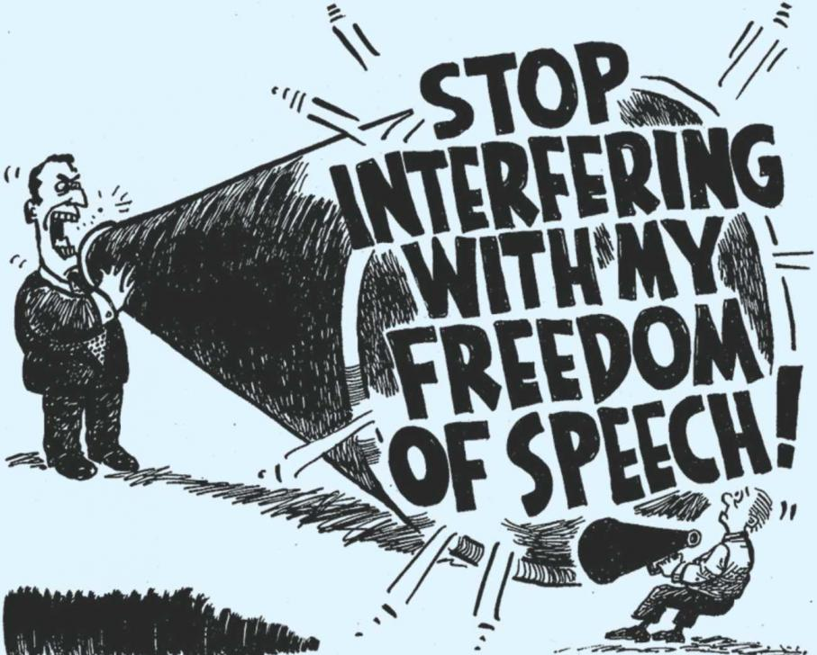
Tensions between Freedom and Security in Contemporary World
Spain
Law 4/2014, citizen security law. ( L.O. 4/2015, 30th of march, de “protección de la seguridad ciudadana” (large fines, human rights limitation e.g. demonstrations, freedom of speech, free movement of persons, the stop and search process, etc.).
Appeal in the Constitutional Court

Slide 11
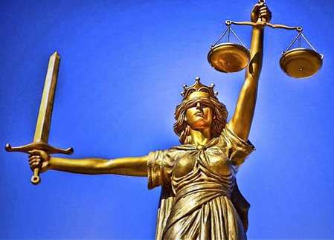
Tensions between Freedom and Security in Contemporary World
- Ley 36/2015, de Seguridad Nacional: “situation of interest for National Security ", directed by the President of the Government. Creates the Sectoral Conference for National Security Affairs, organ of inter-administrative cooperation and also with the private sector.

Slide 12
Tensions between Freedom and Security in Contemporary World
Two current examples
USA
http://www.univision.com/noticias/politica/una-semana-13-polemicas-ordenes-ejecutivas-asi-han-sido-los-primeros-siete-dias-de-trump
http://www.telemundo47.com/noticias/eeuu/Juez-federal-detiene-orden-ejecutiva-trump-412744703.html

Slide 13
Tensions between Freedom and Security in Contemporary World
France
http://www.elmundo.es/internacional/2016/03/30/56fbae1646163f887e8b4582.html
https://www.es.amnesty.org/en-que-estamos/noticias/noticia/articulo/francia-la-renovacion-del-estado-de-excepcion-amenaza-con-normalizar-medidas-de-emergencia/
https://www.lavozdegalicia.es/noticia/internacional/2017/11/01/macron-permanente-estado-excepcion-francia/0003_201711G1P21991.htm

Slide 14
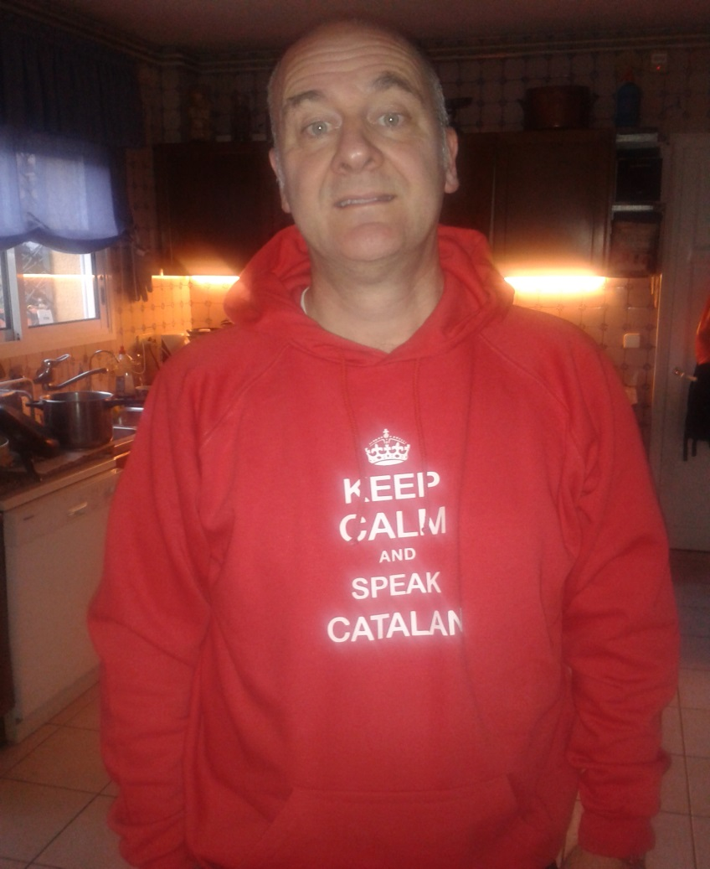


Tensions between Freedom and Security in Contemporary World
THANK YOU FOR YOUR ATTENTION.
Q and A.
Joan Lluís Pérez Francesch
joanlluis.perez.francesch@uab.cat

